Slide 1
Solutions to Climate Change: Growing Decent Jobs
Prof. Robert Pollin
University of Massachusetts-Amherst
for ECOSOC 2015 Integration Segment 3/31/15

Slide 2
20-Year Global Climate Stabilization Program
Program: Invest ~ 1.5% per year over Business-as-Usual Scenarios on Clean Energy for 20 years
1% per year on Clean Renewable Energy
0.5% per year on Energy Efficiency
Results:
40% reduction in global CO₂ emissions
Reach IPCC 20-year emission reduction goal
Major expansion in employment opportunities in all regions

Slide 3
Key is that Clean Energy Investments are Cost Effective
Energy Efficiency Investments save money and reduce emissions
Clean Renewable Energy Investments are either at or approaching cost parity with fossil fuels

Slide 4
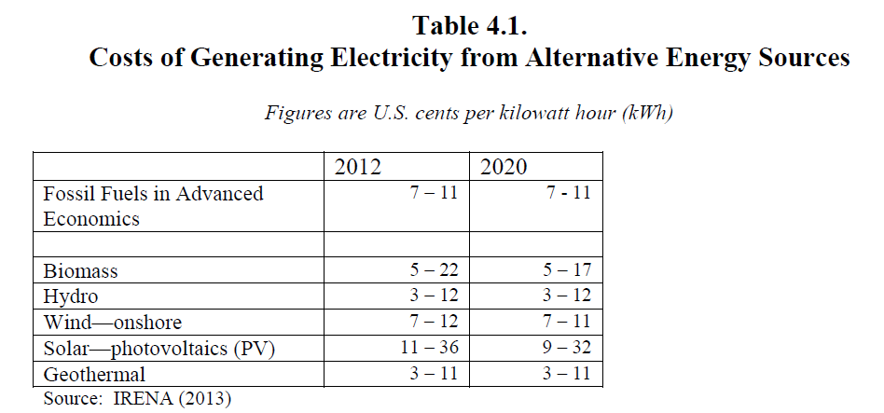

Slide 5
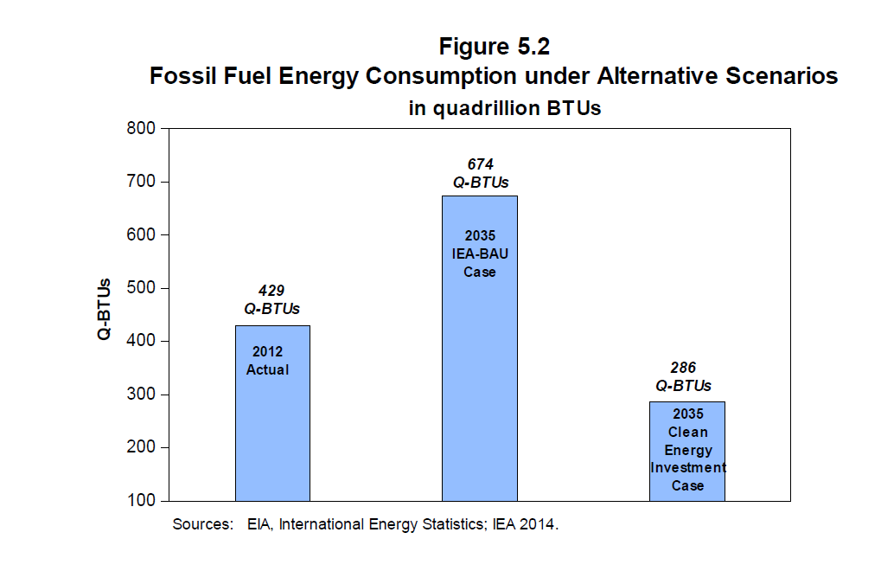

Slide 6
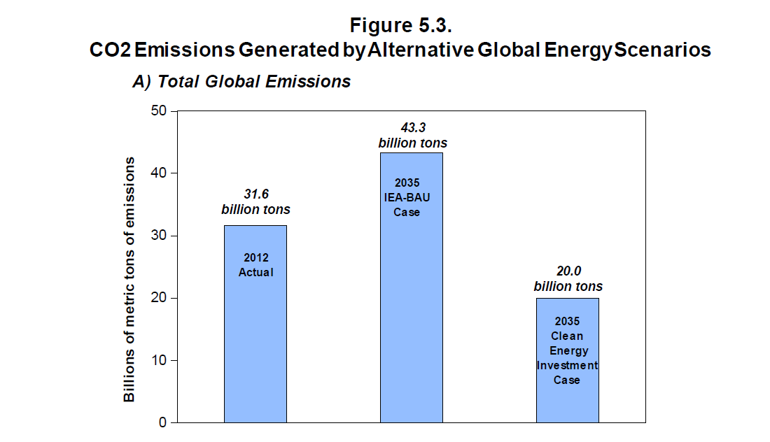

Slide 7
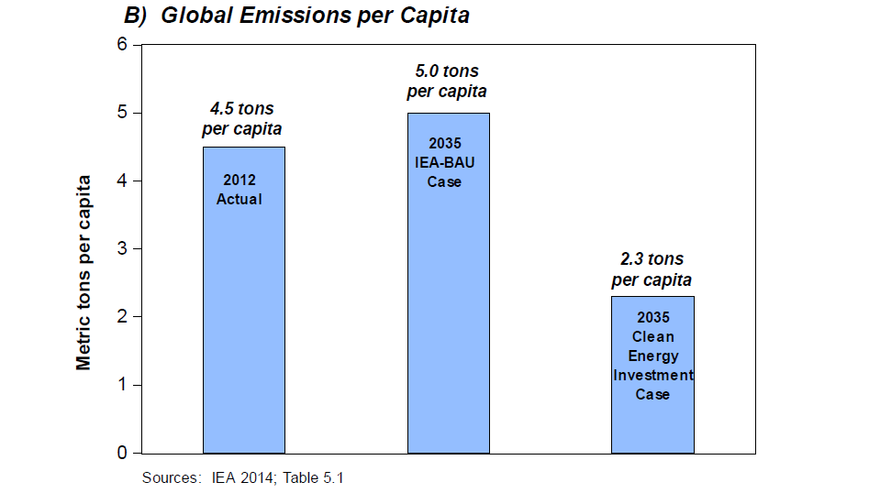

Slide 8
Employment Impacts of Clean Energy Investments
Major Net Positive Job Creation relative to maintaining Fossil Fuel Production
Due to:
Increased Labor Intensity
Increased Domestic Content

Slide 9
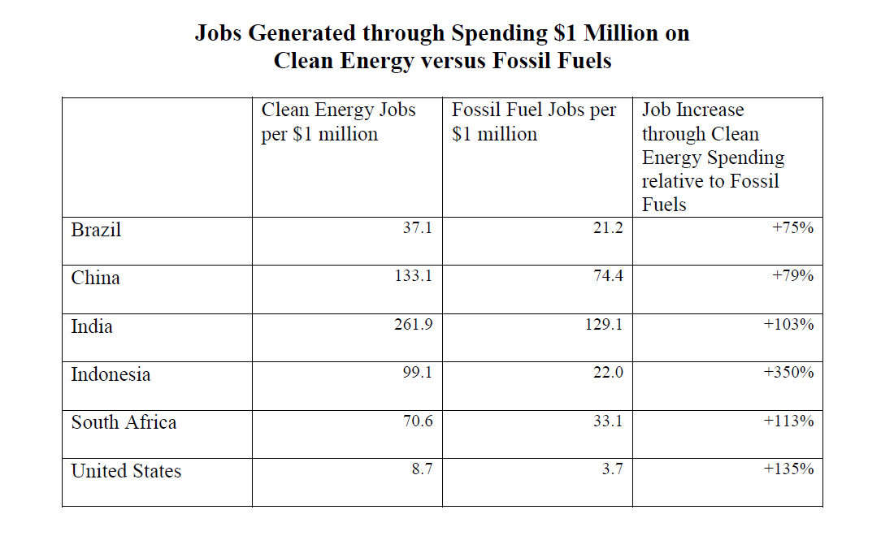

Slide 10
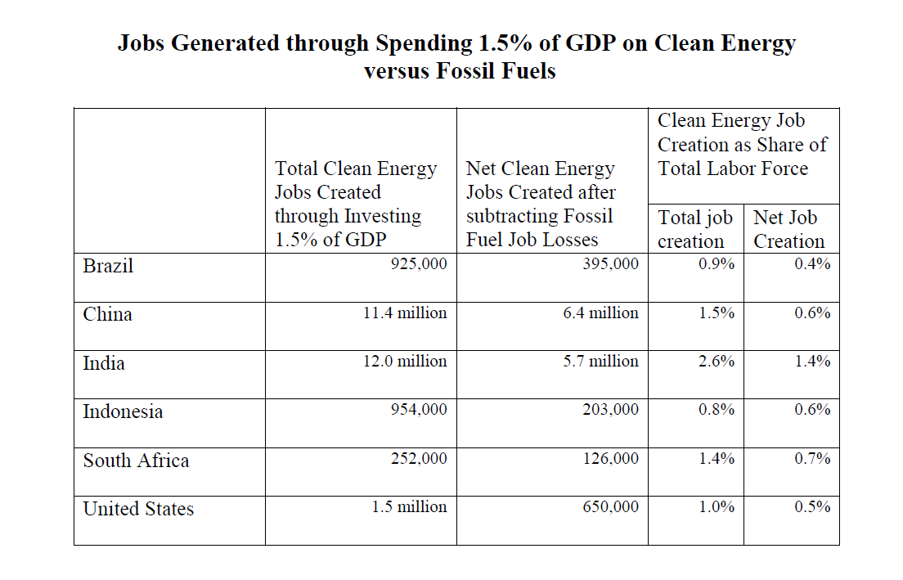

Slide 11
Relative Job Quality through Clean Energy versus Fossil Fuels
Significant increases in agriculture, construction, manufacturing jobs
General educational levels comparable to fossil fuel jobs
Specific skill training needs will emerge
High proportion of informal jobs
Opportunities to formalize informal activities
Gender balance
Need to raise employment opportunities for women in construction and manufacturing

Slide 12
Just Transition for Fossil Fuel Sector Workers and Communities
Must be major focus of overall Clean Energy Investment Program
Alternative employment opportunities
Training
Relocation
Support for New Investments in Affected Communities
Estimated Costs in U.S.
~ $1 billion per year within overall $200 billion program

