Slide 1
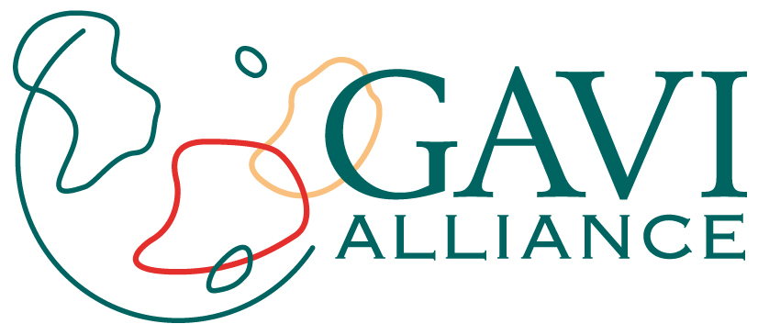


Health Systems Funding Platform update
Julian Lob-Levyt
ECOSOC Coordination Segment
United Nations Headquarters, 6 July 2010

Slide 2
Overview
GAVI Alliance and MDG 4
Health Systems Funding Platform
1

Slide 3
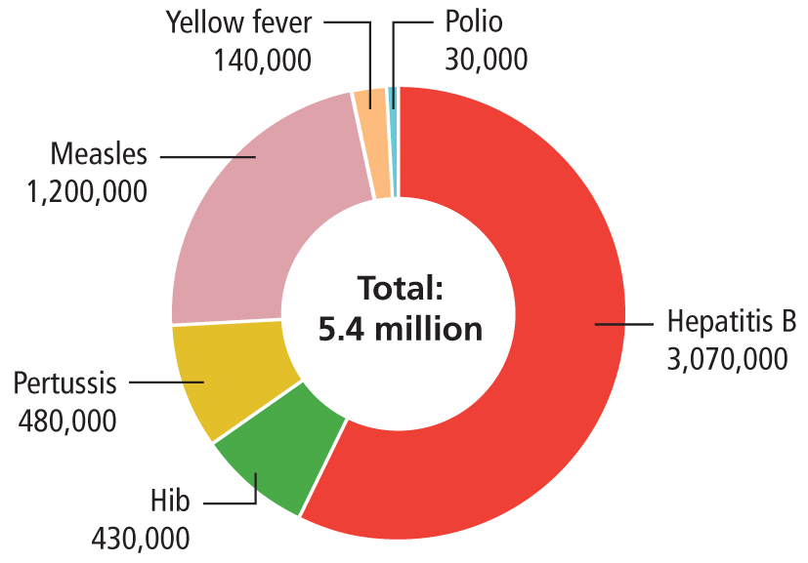
Achieving MDG 4: over five million future deaths prevented
Results from routine immunisation and one-off tactical investments, by vaccine
Source: These estimates and projections are produced by the WHO Department of Immunization, Vaccines and Biologicals, based on the most up to date data and models available as of January 2010
2
Notes:
Future deaths averted with hepatitis B, Hib and pertussis vaccines, and
Impact of one-off tactical investments in:
- Yellow fever – based on campaigns conducted in 2007-2008,
- Measles - GAVI provided 28% of the funding of Measles Initiative. WHO calculated that GAVI has thus supported countries to prevent approximately 1.2 million measles deaths of a total of 4.3 million deaths averted from 2000-2008.
Polio – GAVI’s investment in Global Polio Eradication Initiative in 2007-2008 helped avert more than 30,000 deaths from polio AND helped to prevent 600,000 cases of paralytic polio.
MNT – has yet to be included.
Total: 5,350,000

Slide 4
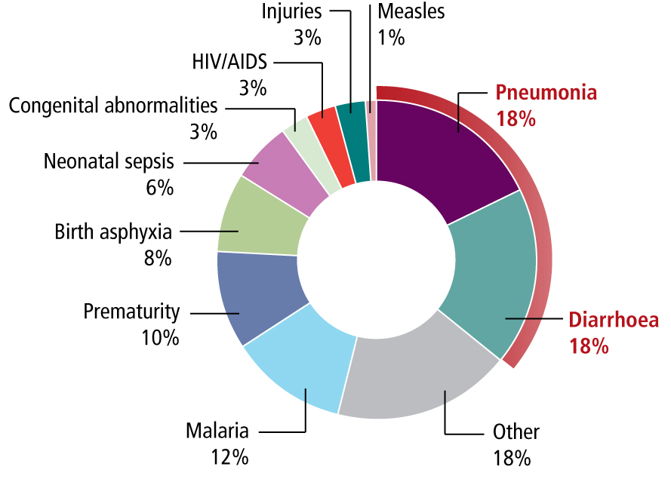
Causes of under-five deaths in low-income countries
Source: WHO, World Health Statistics 2010
Notes:
Pneumonia and diarrhoeal diseases are the leading causes of infectious disease causing death in children under the age of five.
Every year over two million children die from vaccine-preventable diseases.
Deaths in low-income countries account for 95% of all child deaths.
Pneumonia and diarrhoea together account for 36% of child deaths worldwide.
GAVI has the vaccines to prevent many of the major child killer diseases, including the main causes of pneumonia and severe diarrhoea.

Slide 5
Addressing major child killer diseases: pneumonia and diarrhoea
Pneumonia – leading cause of child deaths
Diarrhoea – second most common cause of child mortality
  Rotavirus causes majority of severe diarrhoea cases
GAVI Alliance: paving the way for pneumococcal and rotavirus vaccines
3
Notes:
GAVI Alliance:
Working with UNICEF, WHO, the World Bank, donors, CSOs and countries

Slide 6
Overview
GAVI Alliance and MDG 4
Health Systems Funding Platform
4

Slide 7
What is the purpose of the Health Systems Funding Platform?
“To improve health outcomes through strengthening countries’ health systems to deliver health services equitably and sustainably (focussing on all health MDGs) and to use resources more effectively and efficiently”
5
Notes:
High Level Task Force Recommendation:
Establish a health systems funding platform for the Global Fund, GAVI Alliance, the World Bank and others to coordinate, mobilize, streamline and channel the flow of existing and new international resources to support national health strategies.

Slide 8
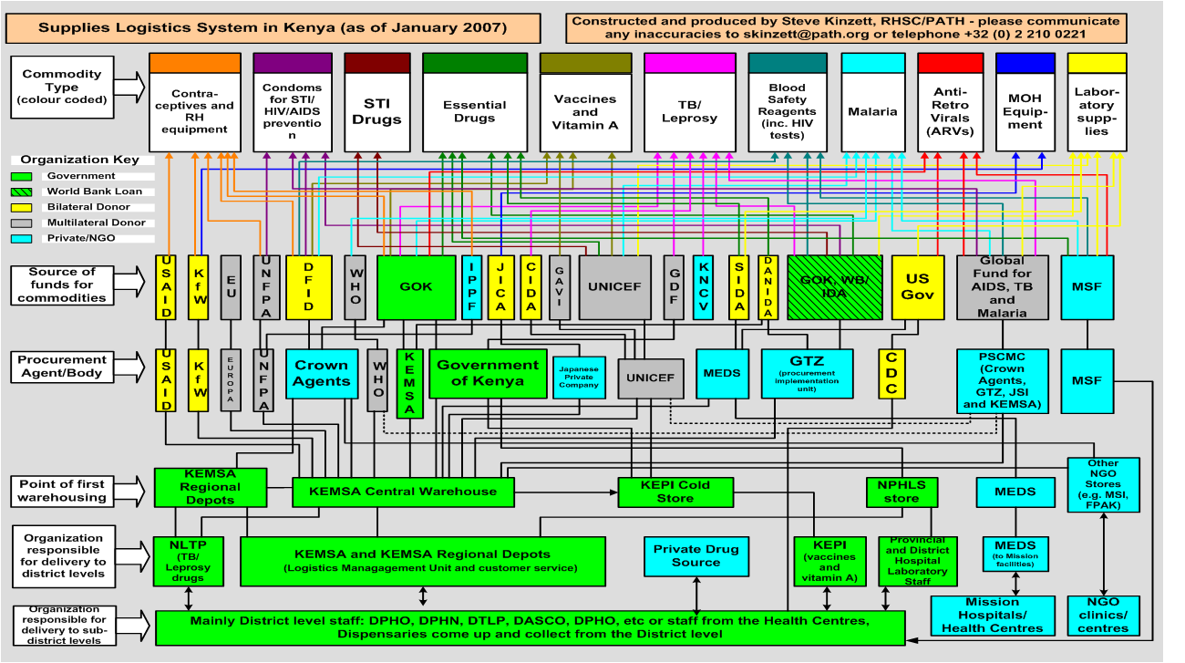
What’s the problem?
Source: Kinzett, 2007.
6
Notes:
This is a map of health sector procurement in Kenya from a few years ago.
Many of you are familiar with this slide, which doesn’t single out any particular agency, we’re all in it together, and have a responsibility to really start ‘walking the talk’
The new global architecture has brought many benefits, but there is also a cost

Slide 9
Health Systems Funding Platform
More health for the money
Consistent with the draft Joint Action Plan, and IHP+
Accelerates progress on MDGs 4, 5, 6
Country-driven and results-focused
Catalyst for additional resources
One plan, one budget, one results framework
7
Notes:
What’s different?
It’s building on what countries have clearly said they want. Simplification.
It will support one plan, will provide streamlined finance, and will use the same monitoring systems through the joint annual review
What it is not. It is not a new Global Fund, it is not an exclusive club. It is a genuine attempt to provide money better, faster, and more efficiently.
It acknowledges that the main success for any progress is because of domestic investments. It seeks to build on these in a way that is truly complementary.

Slide 10
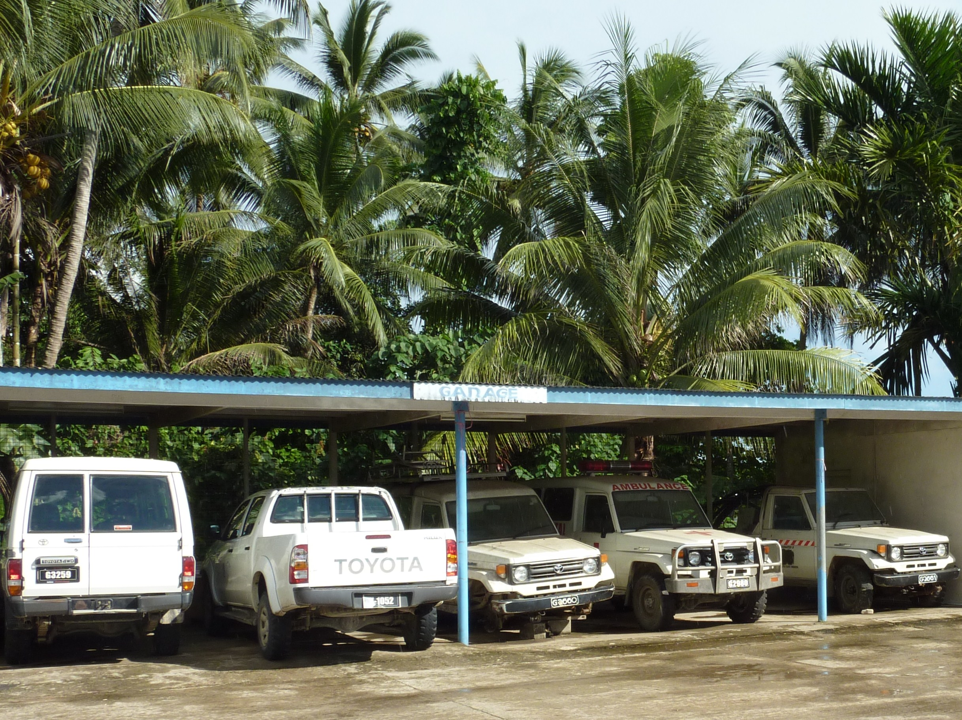
Different vehicles for different programmes: Malaya Province, Solomon Islands
GAVI/09/Geoff Adlide
8
Notes:
HSS and JOINT PLATFORM
Solomon Islands 25 years ago.
Trained staff
Increased vertical funding – different vehicles assigned by different donors:
One for HIV
One for immunisation
One for malaria
Province manager responsible for supervising a network of rural clinics has no transport
This is a fractured health system
Should be more cohesive
Cause: the way donors channel external support

Slide 11
Health Systems Funding Platform
Channeling of funds for health systems
WHO
(facilitation)
World Bank
GAVI
Global Fund
Key inputs
Bilateral and multilateral donors, CSOs
Joint assessment, capacity building and M&E
One plan
One budget
One M&E
framework
MDG
4, 5, and 6
outcomes
Implementation
9
Notes:
This shows schematically how the Health Systems Funding Platform will work.
The key is that funders of HSS harmonise their support upstream and reduce the complexity for developing countries to access external funds. It is aid effectiveness in action. Reducing transaction costs and putting support behind one country plan, one country budget and a single M&E framework. It is about getting results faster. With only 5 years left to the MDGs we have to make a gear change on health service delivery.
With others we are preparing for support to other countries: Cambodia, Ethiopia, Mali, Vietnam, Benin, Yemen, Sierra Leone and D R Congo, to name but a few.

Slide 12
Supporting shifts in delivering health services
Agency-based
Country-based
Proposal-based
National strategy-based
Multiple deadlines
Flexible and aligned to country cycles
Input-based
Results-based
10
Notes:
The Health Systems Funding platform is an example of the clear shift from the cluttered and fragmented approaches of the past to more harmonised and aligned approaches which put countries in the driving seat and focus firmly on results.

Slide 13
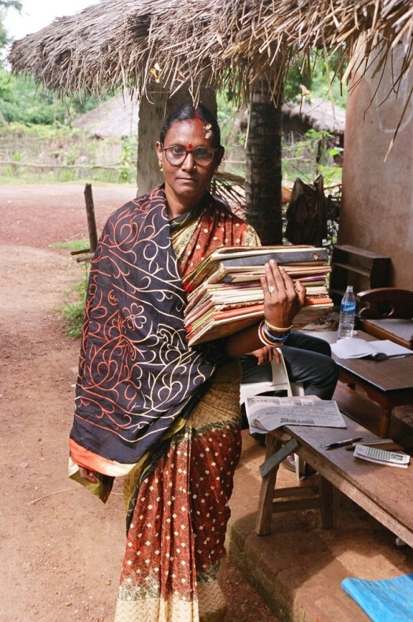
An example from Orissa, India
ECOSOC - 6 July 2010
11
Notes:
This nurse midwife is from Orissa, one of the poorest states in India.
She is carrying over 15 books – each of these books is necessary for disease specific recording of data which is transferred upwards. Often there is no feedback and she herself does not use the data for planning. She spends over 50% of her time filling in these books.
This figure was also confirmed by a time and motion study in Cambodia, undertaken by JICA for nurse midwives in Cambodia
12

Slide 14
Country progress
Joint Financing Agreement in Nepal
Ethiopia, Sierra Leone, Mali, Yemen
  And others: joining up with national planning cycles
Joint review missions
Development of joint application form
Defined common approach to public financial management assessment
12
Notes:
We are working in a different way already in Nepal . GAVI will sign the Joint Financing Agreement by the end of July, with partners including the World Bank, AusAid, DFID, USAID, GTZ and others.
Joint review missions: Transaction costs are currently being reduced in at least 5 countries where the platform partners participate in joint review missions (Vietnam, Nepal, Cambodia, Mali, and Ethiopia).
Joint application form:
1st draft complete by end of August 2010 and ready for country trials
National Health Plan as application form:
1st draft complete by end of August 2010 and ready for country trials
Common public financial management assessment:
Common approach to public financial management timing and assessment
One methodology to assess systems and diagnose risk
Common financial reporting and one external audit of country programmes

