Slide 1
Global Facility for Disaster Reduction and Recovery
Working in partnership with humanitarian and development actors
to reduce the risks of natural hazards
Reducing risks of humanitarian emergencies
for sustainable development
New York, July 15, 2010
Saroj Kumar Jha
Manager GFDRR, The World Bank
GFDRR is able to help developing countries reduce their vulnerability to natural disasters and adapt to climate change, thanks to the continued support of our partners: ACP Secretariat, Australia, Belgium, Brazil, Canada, Denmark, European Commission, Finland, France, Germany, India, Ireland, Italy, Japan, Luxembourg, the Netherlands, Norway, Spain, Sweden, Switzerland, Turkey, United Kingdom, United States, UN International Strategy for Disaster Reduction, and the World Bank.

Slide 2
Humanitarian emergencies and the sustainable development paradigm
GFDRR is able to help developing countries reduce their vulnerability to natural disasters and adapt to climate change, thanks to the continued support of our partners: ACP Secretariat, Australia, Belgium, Brazil, Canada, Denmark, European Commission, Finland, France, Germany, India, Ireland, Italy, Japan, Luxembourg, the Netherlands, Norway, Spain, Sweden, Switzerland, Turkey, United Kingdom, United States, UN International Strategy for Disaster Reduction, and the World Bank.

Slide 3
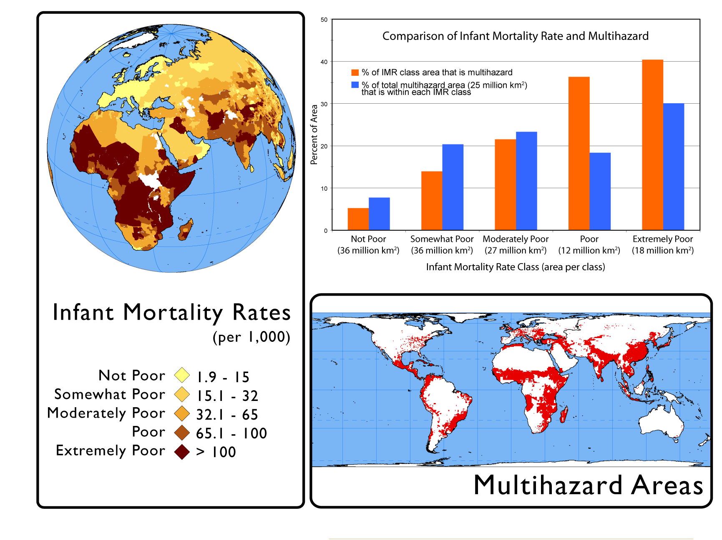
Poverty is the greatest
vulnerability multiplier
70% of natural ‘disaster’ hotspots occupied
by people in moderate and extreme poverty.
One third of all poor and extremely poor people live in multi-hazard hotspots.
Source: Global Hotspots Study: World Bank/Columbia University
GFDRR is able to help developing countries reduce their vulnerability to natural disasters and adapt to climate change, thanks to the continued support of our partners: ACP Secretariat, Australia, Belgium, Brazil, Canada, Denmark, European Commission, Finland, France, Germany, India, Ireland, Italy, Japan, Luxembourg, the Netherlands, Norway, Spain, Sweden, Switzerland, Turkey, United Kingdom, United States, UN International Strategy for Disaster Reduction, and the World Bank.

Slide 4
Natural hazards become ‘unnatural disasters’ when vulnerabilities are not managed as integral to development processes.
Disasters cause adverse impact on human and economic development
Average loss of employment: 2-10%
Haiti earthquake: 8.5 %decline
Average loss of GDP : 2-15%
Samoa tsunami(2009):120% of GDP
Haiti earthquake(2010): 120% of GDP
And the humanitarian consequence is that communities and nations fall into vicious poverty traps pushing more millions into extreme poverty each year
Incidence of poverty higher in hazard-prone areas
In Bangladesh, 60% of poor/extremely poor vulnerable to hazards
2-4% increase in extreme poverty due to disasters
265,000 people fall into poverty each year due to droughts and floods in Malawi
GFDRR is able to help developing countries reduce their vulnerability to natural disasters and adapt to climate change, thanks to the continued support of our partners: ACP Secretariat, Australia, Belgium, Brazil, Canada, Denmark, European Commission, Finland, France, Germany, India, Ireland, Italy, Japan, Luxembourg, the Netherlands, Norway, Spain, Sweden, Switzerland, Turkey, United Kingdom, United States, UN International Strategy for Disaster Reduction, and the World Bank.

Slide 5
Growth and poverty alleviation is not sustainable without integrating vulnerability and risk management considerations into country development strategies.
Disaster prevention is economical and it pays to anticipate and manage natural disaster risks and other global scale risks.
however, response to humanitarian consequences also offer unique opportunity to introduce longer term changes in vulnerability and risk management for sustainable development.
Build back better strategy to build resilience in vulnerable communities and economies.
GFDRR is able to help developing countries reduce their vulnerability to natural disasters and adapt to climate change, thanks to the continued support of our partners: ACP Secretariat, Australia, Belgium, Brazil, Canada, Denmark, European Commission, Finland, France, Germany, India, Ireland, Italy, Japan, Luxembourg, the Netherlands, Norway, Spain, Sweden, Switzerland, Turkey, United Kingdom, United States, UN International Strategy for Disaster Reduction, and the World Bank.

Slide 6
Development perspective of humanitarian consequences@ World Bank
GFDRR is able to help developing countries reduce their vulnerability to natural disasters and adapt to climate change, thanks to the continued support of our partners: ACP Secretariat, Australia, Belgium, Brazil, Canada, Denmark, European Commission, Finland, France, Germany, India, Ireland, Italy, Japan, Luxembourg, the Netherlands, Norway, Spain, Sweden, Switzerland, Turkey, United Kingdom, United States, UN International Strategy for Disaster Reduction, and the World Bank.

Slide 7
Institutional context of humanitarian emergencies
Rapid Response Framework: Board approval of a new Framework for Rapid Response to Emergencies and Crises for rapid, flexible and innovative response to Government requests, and provides for:
Integration of risk management considerations in Poverty Reduction Strategies and Country Assistance Strategies.
Rapid Response that integrates risk and vulnerability reduction considerations
Working in partnership with UN and other international actors
Assistance following humanitarian emergencies already a core business for the Bank: Disaster operations account for 12-15% of annual WB portfolio [source: IEG & GFDRR Portfolio Review]
During 1984-2009
628 “disaster projects” with a total of $31,71 billion
More ex post than ex ante
Recognition that more needs to be done to mainstream disaster prevention in national development agenda.
Development investments must be disaster-sensitive
GFDRR is able to help developing countries reduce their vulnerability to natural disasters and adapt to climate change, thanks to the continued support of our partners: ACP Secretariat, Australia, Belgium, Brazil, Canada, Denmark, European Commission, Finland, France, Germany, India, Ireland, Italy, Japan, Luxembourg, the Netherlands, Norway, Spain, Sweden, Switzerland, Turkey, United Kingdom, United States, UN International Strategy for Disaster Reduction, and the World Bank.

Slide 8
World Bank responds to the global challenge
Following the devastating Indian Ocean tsunami , World leaders adopt Hyogo Framework of Action (HFA) to make disaster risk reduction a national development priority [2005]
IPCC report confirms likely increase in the incidence of disasters due to haphazard urbanization, environmental degradation and anticipated climatic impacts
The UN International Strategy for Disaster Reduction (UN ISDR) is strengthened with participation of national governments.
World leaders seek greater engagement of the World Bank in disaster risk reduction to help developing countries attain MDGs.
World Bank convenes first meeting of donors and UN in Washington DC in September 2006 to discuss a global partnership in Disaster Risk Reduction
GFDRR is able to help developing countries reduce their vulnerability to natural disasters and adapt to climate change, thanks to the continued support of our partners: ACP Secretariat, Australia, Belgium, Brazil, Canada, Denmark, European Commission, Finland, France, Germany, India, Ireland, Italy, Japan, Luxembourg, the Netherlands, Norway, Spain, Sweden, Switzerland, Turkey, United Kingdom, United States, UN International Strategy for Disaster Reduction, and the World Bank.

Slide 9
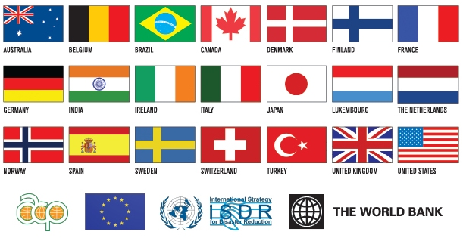
Bank-managed GFDRR is setting new standards for a partnership that is global and inclusive

Slide 10
Key results that GFDRR is helping most vulnerable countries to achieve
Country Policy Dialogue and capacity development for mainstreaming DRR in Development
Identifying disaster risks and formulation of longer term risk reduction strategies
Advancing comprehensive action on early warning systems as the most economic DRR action
Post-Disaster Needs Assessment as a tool for international cooperation and to make DRR a priority in post-disaster recovery and reconstruction
Develop and implement innovative risk financing and disaster insurance options
Leverage additional investments in disaster prevention and preparedness
GFDRR is able to help developing countries reduce their vulnerability to natural disasters and adapt to climate change, thanks to the continued support of our partners: ACP Secretariat, Australia, Belgium, Brazil, Canada, Denmark, European Commission, Finland, France, Germany, India, Ireland, Italy, Japan, Luxembourg, the Netherlands, Norway, Spain, Sweden, Switzerland, Turkey, United Kingdom, United States, UN International Strategy for Disaster Reduction, and the World Bank.

Slide 11
Ensuring upstream engagement in CASs/PRSs and investments
GFDRR’s evidence-based advice on mainstreaming DRR to nearly 70 countries and 138 development strategies/investments. Examples of recent impacts:
In Sao Tome and Principe, present more information on its natural disaster risks and mitigation strategy, adopt a vulnerability reduction and adaptation plan to climate change, and ensure that critical public infrastructure is resilient to disasters.
In Burundi ensure that future PRSP address impacts of disasters, and draw up an effective DRR strategy implementation.
In the Central African Republic, emphasize on disaster-resilient structures.
In Togo, promote economic recovery by preventing and managing disasters through more analytics and responsive DRM policy measures
Ethiopia recognized that future CASes should identify DRR knowledge and investment instruments as did Djibouti, Dominican Republic, Guyana, Paraguay, Philippines, and Yemen
Haiti detailed how it would “disaster-proof” its Poverty Reduction strategy.
In Djibouti, Honduras, Indonesia, and Turkey, they refined their respective results matrix to strongly reflect DRR.
GFDRR is able to help developing countries reduce their vulnerability to natural disasters and adapt to climate change, thanks to the continued support of our partners: ACP Secretariat, Australia, Belgium, Brazil, Canada, Denmark, European Commission, Finland, France, Germany, India, Ireland, Italy, Japan, Luxembourg, the Netherlands, Norway, Spain, Sweden, Switzerland, Turkey, United Kingdom, United States, UN International Strategy for Disaster Reduction, and the World Bank.

Slide 12
More and more developing countries are mainstreaming vulnerability reduction into their national development strategies
GFDRR is able to help developing countries reduce their vulnerability to natural disasters and adapt to climate change, thanks to the continued support of our partners: ACP Secretariat, Australia, Belgium, Brazil, Canada, Denmark, European Commission, Finland, France, Germany, India, Ireland, Italy, Japan, Luxembourg, the Netherlands, Norway, Spain, Sweden, Switzerland, Turkey, United Kingdom, United States, UN International Strategy for Disaster Reduction, and the World Bank.

Slide 13
and, Bank’s Country Assistance Strategies are also increasingly mainstreaming vulnerability reduction into investments
GFDRR is able to help developing countries reduce their vulnerability to natural disasters and adapt to climate change, thanks to the continued support of our partners: ACP Secretariat, Australia, Belgium, Brazil, Canada, Denmark, European Commission, Finland, France, Germany, India, Ireland, Italy, Japan, Luxembourg, the Netherlands, Norway, Spain, Sweden, Switzerland, Turkey, United Kingdom, United States, UN International Strategy for Disaster Reduction, and the World Bank.

Slide 14
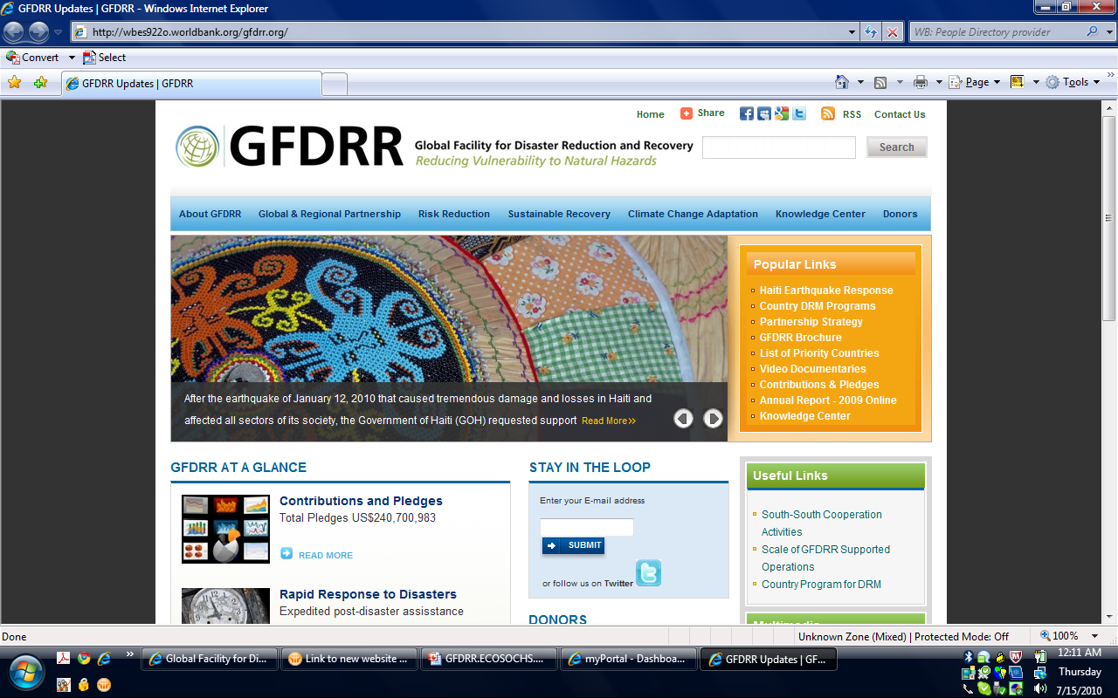
Thank you
www.gfdrr.org
GFDRR is able to help developing countries reduce their vulnerability to natural disasters and adapt to climate change, thanks to the continued support of our partners: ACP Secretariat, Australia, Belgium, Brazil, Canada, Denmark, European Commission, Finland, France, Germany, India, Ireland, Italy, Japan, Luxembourg, the Netherlands, Norway, Spain, Sweden, Switzerland, Turkey, United Kingdom, United States, UN International Strategy for Disaster Reduction, and the World Bank.

