Slide 1
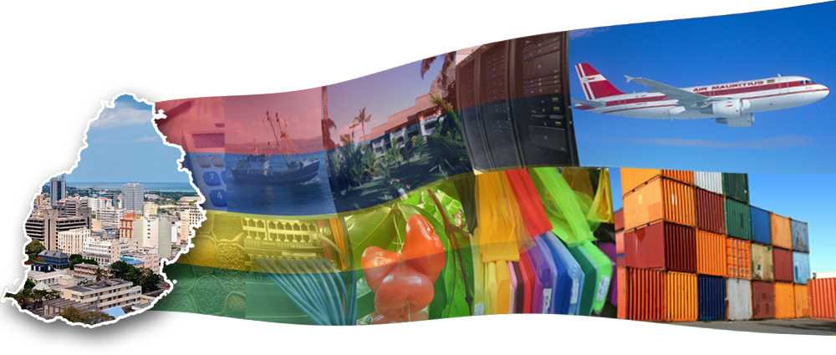
ECOSOC High-Level Segment: Special Policy Dialogue on Education Challenges in Africa and LDCs
H Dansinghani, Ministry of Education & HR, Mauritius

Slide 2
The Rationale for Post-primary Education in LDCs
Access to primary education has increased dramatically in LDCs over the last decade (the median GER in primary education in Africa increased from 80 percent in 1999 to 102 percent in 2010)
However
Generally accepted that 90 % of young people receive their skills training in the informal sector
Increasing personal and social aspirations place situate education as the key driver for mobility
Expansion of Post-Primary education to meet socio-economic development becoming more central to national development strategies

Slide 3
The Rationale for Post-primary Education ( 2)
Transition from school to work remains problematic in most African countries. In most countries, it takes more than 3 to 4 years to enter the labor market.

Slide 4
The challenge of developing post-primary education strategies in LDCs (1)
The low development of post-primary education is rapidly becoming a key constraint to youth employment and economic development
Strategies for the development of post-primary education in LDCs ought to be informed by specificities of the labor markets in these countries, including the predominant share of the informal sector

Slide 5
The challenge of developing post-primary education strategies in LDCs (2)
There is limited institutional capacity of sector ministries to lead and implement the on-going reforms and innovations.
Resource Gap
Difficulties in maintaining national macroeconomic stability as a result of developments in the external environment.
Non- affordability and fiscal non- sustainability negatively impact on external efficiency
Shift from occupation-related skills to the development of “ soft “ skills, including
- communication skills
- problem solving skill
- practical skills

Slide 6
The Mauritius Experience
Traditionally, a high social demand for education in Mauritius
Strong political commitment to education on the part of successive Governments and hence continuity in implementation of major education policies
Different national development plans since independence had similar objectives for education, mainly
- broadening access,
- equality of opportunity/ Equity,
- diversified curriculum,
- promotion of science and technology,
- technical and vocational education,
- improvement of the quality of education, and
- strengthening management of the education system

Slide 7
The Mauritius Experience
Expanding the supply of skills
  Introduction of free and compulsory education up to 16 years old (2005 reform) to meet both social and economic imperatives
  Pedagogical innovations to increase the secondary completion rate
  Creation of prevocational courses to cater for primary education dropouts
  Significant investment in formal TVET
  Major Objectives:
  Delivering a TVET- demand Approach v/s traditional Focus on Supply-Side Skills Development
  Dealing with negative social perception of technical versus academic education/ stigma attached to TVET
  Building pathways between TVET and Higher Education

Slide 8
Quality Training
HRDC
MQA
Fund –
facilitator
Regulator
Quality Training
MITD
Training provision

Slide 9
Current challenges: Increase the relevance of skills
Overarching objective:
Transform Mauritius into a knowledge economy
High attrition at lower and upper secondary education levels results in low overall readiness for tertiary education
Low access to tertiary education hampers the capacity of the country to innovate and hinders the development of economic sectors with high growth potential (such as ICT)
Transforming secondary education to improve retention, learning outcomes and reduce inefficiency has the potential to improve significantly the quality of entrants into tertiary education
Implementation of a new vision for tertiary education, based on diversification and focused on the needs of a technology based economy, is key to the transformation of Mauritius as a knowledge economy

Slide 10

Expanding the supply of skills
Education is not just the concern of the Government in Mauritius. The system of education comprises several partners:
-private schools (aided and non-aided);
  -non governmental organisations;
  -education authorities;
  -religious bodies;
  -parastatal institutions;
  -parents and
  -the community at large.

Slide 11

The private sector plays a key role in the provision of education
At independence in 1968, State provision = 6% v/s Private sector = 94% (private-aided 16% and private non-aided 78%)
In 2005: 83% for pre-primary;
25% primary;
66% secondary; 58% pre-vocational, and
+ 50% for tertiary
  Partnering with the private sector in TVET: the introduction of apprenticeships has allowed a significant increase in enrolments, while maintaining costs sustainable and strengthening the links between training and industries
Corporate Social responsibility

Slide 12

The public-private participation ratio is likely to change in Mauritius
With the projected decline in enrolment in primary and secondary, the Government plan may not necessarily lead to the closure of private schools but would bring about a potentially positive effect by implementing quality measures such as decreasing class sizes

Slide 13

The Mauritian experience shows that access, equity, quality, and relevance have on the whole improved significantly through this innovative PPP delivery system
Government has always honoured its contractual obligations towards private schools
It has made special concessions so that they may continue to offer efficient educational services to Mauritian children.
Government has never taken any action with a view to reduce the importance or to close or nationalise private schools.
It has believed more in a PPP approach to the provision of education but reserving the right to regulate and intervene to ensure access, equity and quality.

Slide 14

Thank You

